Slide 1

Student Management System Database
A Relational Database Design and Reporting Project
Presented by : TEAM B
Date : Saturday, 18th October 2025
Time : 8:30pm WAT

Slide 2
Objectives
🧭 Main Goal
To design and implement a relational database for a Student Management System (SMS) , to store and manage data and enable administrative functions.
💡Why This Matters
A well-structured SMS database improves:
Academic record-keeping
Communication
Data-driven decision-making

Slide 3

Tables Created
Table Name
Key Columns
🎓Students | StudentID, Name, Gender, DOB, DepartmentID
🗂️ Departments | DepartmentID, DepartmentName
📚Courses | CourseID, CourseName, DepartmentID
📝Enrollment | EnrollmentID, StudentID, CourseID, EnrollmentDate
👨‍🏫 Instructors CourseInstructors | InstructorID, Name, Gender, Email, Hire_Date, DepartmentID AssignmentID, InstructorID,CourseID

Slide 4

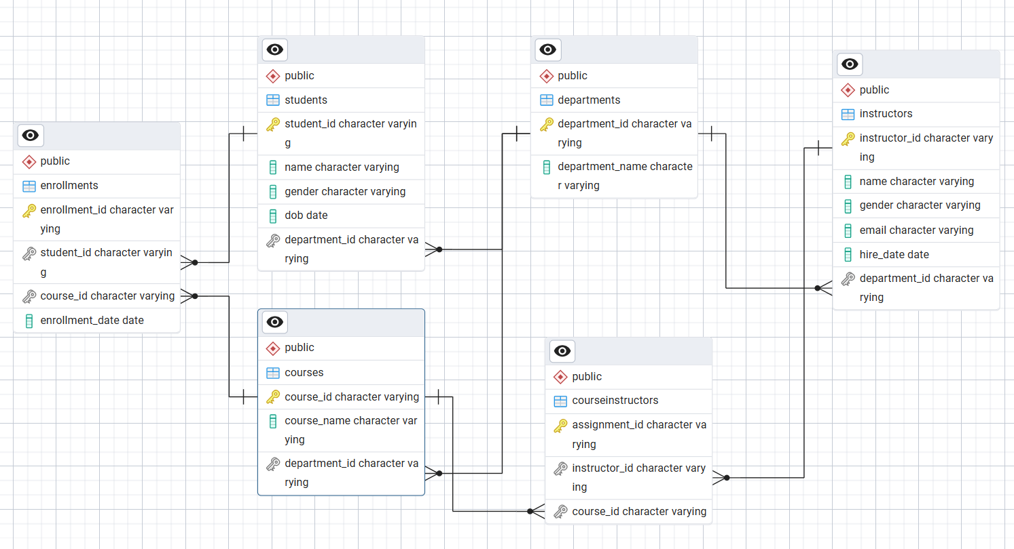

Entity Relationship Diagram (ERD)
Entity Relationships
One Department has many Students
One Department offers many Courses
One Student can enrol in many Courses
One Instructor teaches many Courses
Many Instructors teach many Courses
Relational Structure
Primary Keys
Foreign Keys

Slide 5

Data Population
Each table was populated with realistic sample data
6 Departments
20 Courses
15 Instructors
50 Students
100 Enrolment Records
28 Course Assignments
This dataset provides a realistic simulation of university operations.

Slide 6

Student & Enrolment Reports
Total number of students per course
Students enrolled in multiple courses and the courses they are taking
Student count per department

Slide 7
Reporting Results
Introduction to Programming , Data Structures and Linear Algebra have the highest enrolment(7) and Academic Writing has the lowest(3)
49 students are enrolled in multiple courses, 1 student registered three courses, this is the student with the highest number of course enrolments
The Computer Science department has the highest number of students(12), Physics and Biology departments have the least number of students(7)

Slide 8

Course & Instructor Analysis
Courses with the highest enrolment
Linear Algebra, Introduction to Programming, and Data Structures
Department with the fewest students
Physics and Biology

Slide 9

Data Integrity & Operational Insights
All students are actively registered in at least one course
Each student takes an average of 2 courses
Mr. Daniel Peters (Linear Algebra) teaches the most female students
Dr. Okoro & Dr. Kuti (Data Structures) teaches the most male students

Slide 10
Conclusion
The Student Management System (SMS) database demonstrates the power of relational design in efficiently managing academic records
The system supports scalable, flexible, and data-driven decision-making and also ensures flexibility for advanced analytical reporting.

